Slide 2
Stratford Primary School building is 135 years old

Slide 3
In 1881 the old building on Rother Street was condemned – too dangerous! In the case of the infants school I cannot recommend their Lordships to make further payment of the grant unless new and suitable premises be provided. The room is in now way fitted for the purpose of an Infant school, being approached by a steep and dangerous staircase from Mixed school below.

Slide 4
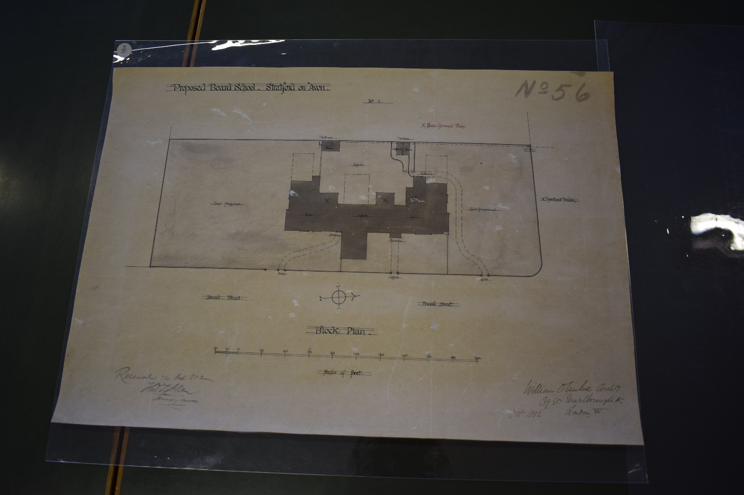
Vegetable plots were bought and a new school planned and built

Slide 7
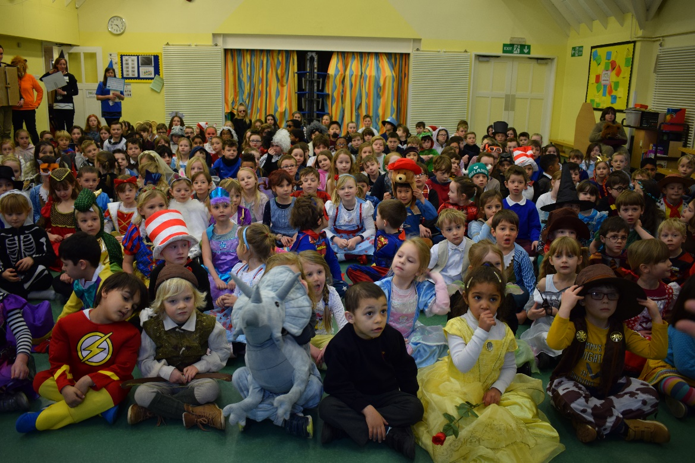
Lots of people have passed through the doors

Slide 8
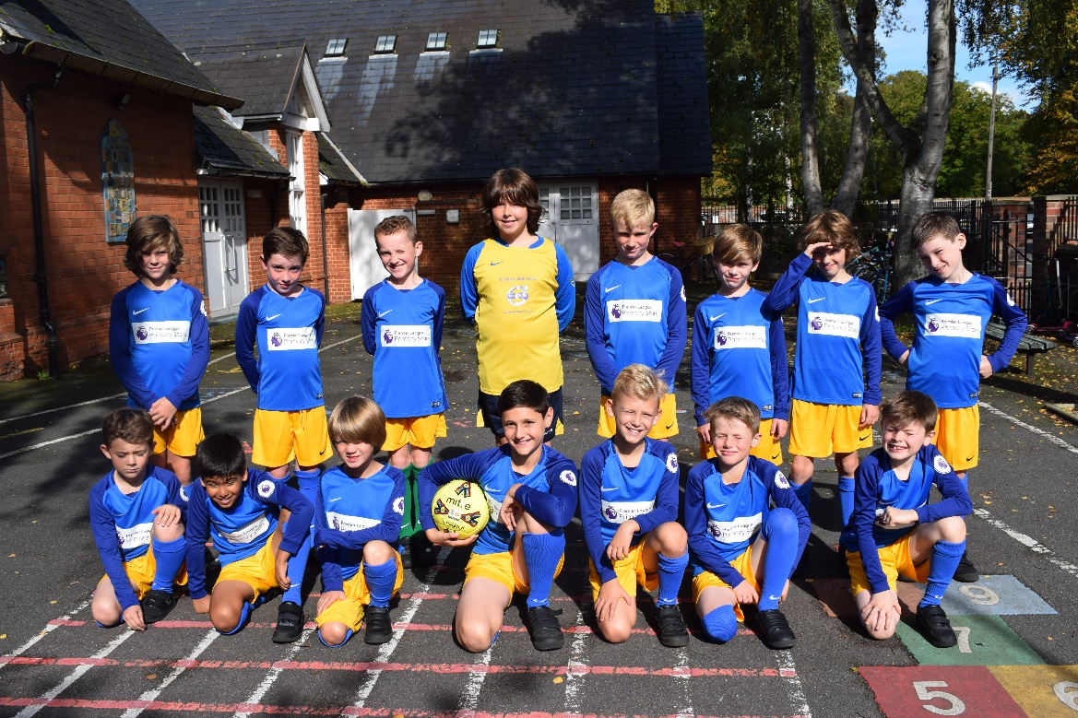
But are they any different?

Slide 9
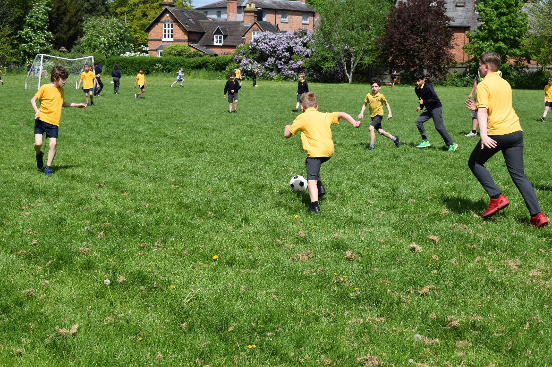
Still full of fun

Slide 10
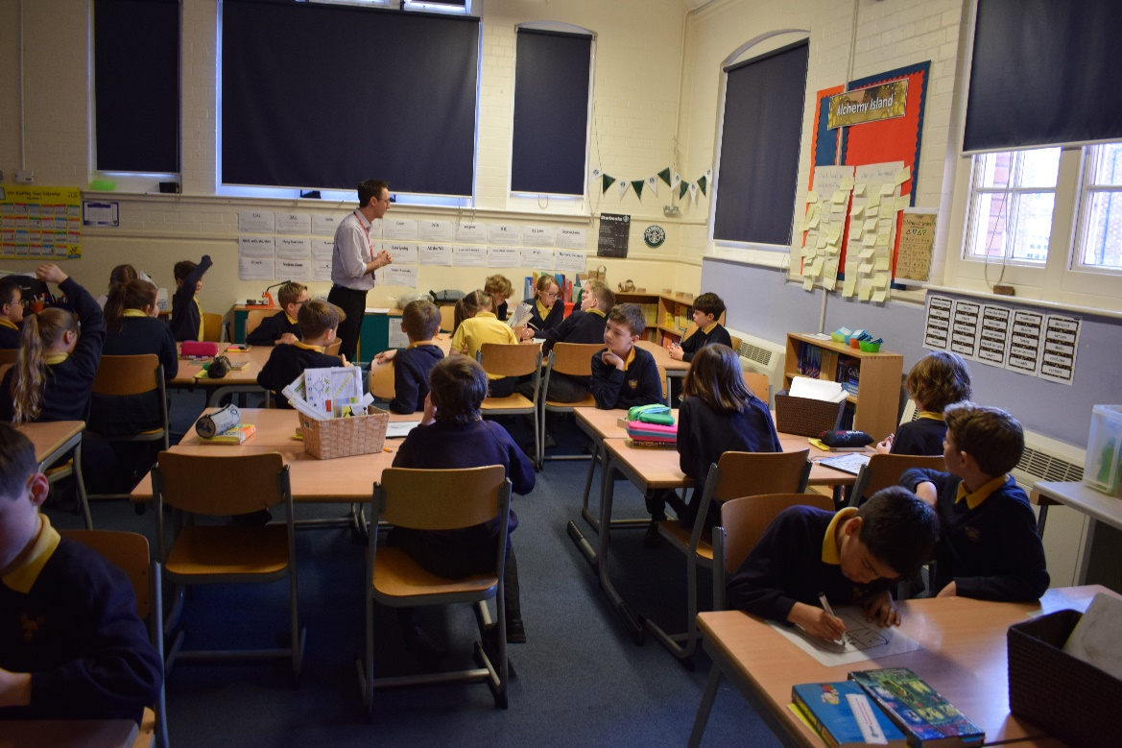
Still learning

Slide 11
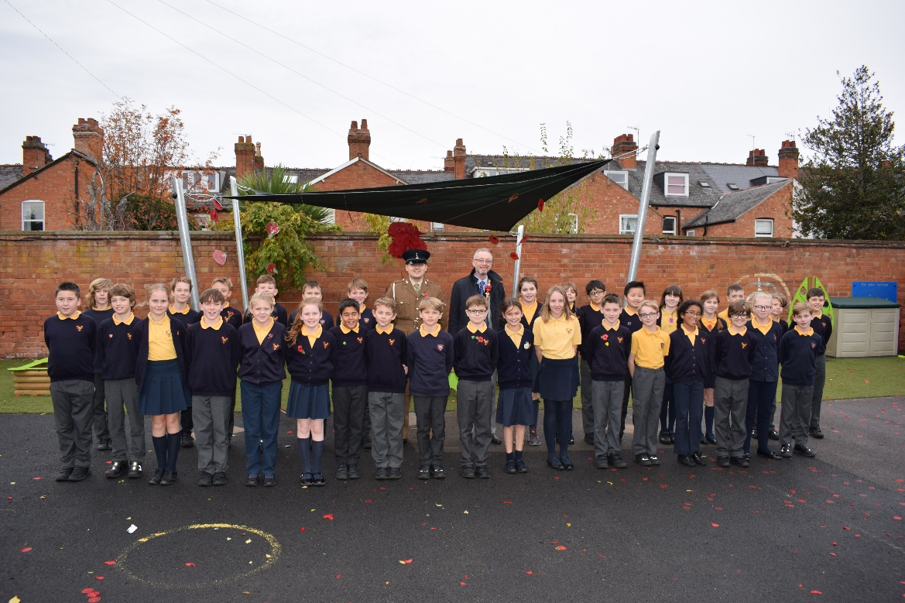
Still proud to be part of Stratford Primary

Slide 12
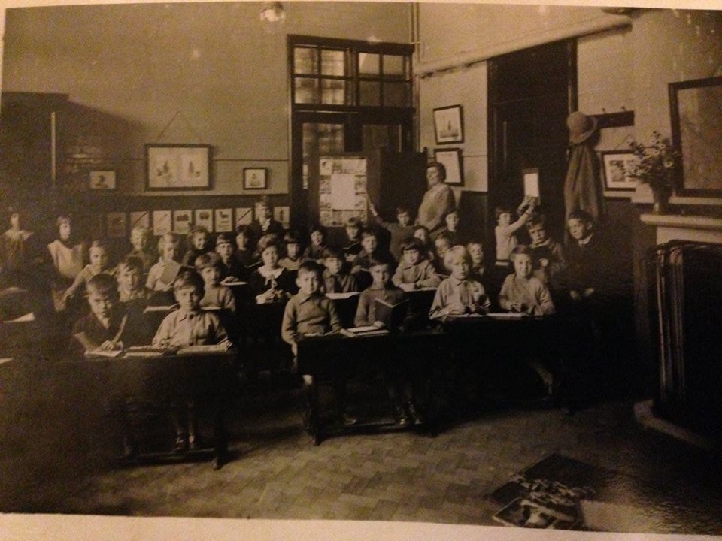

Slide 13
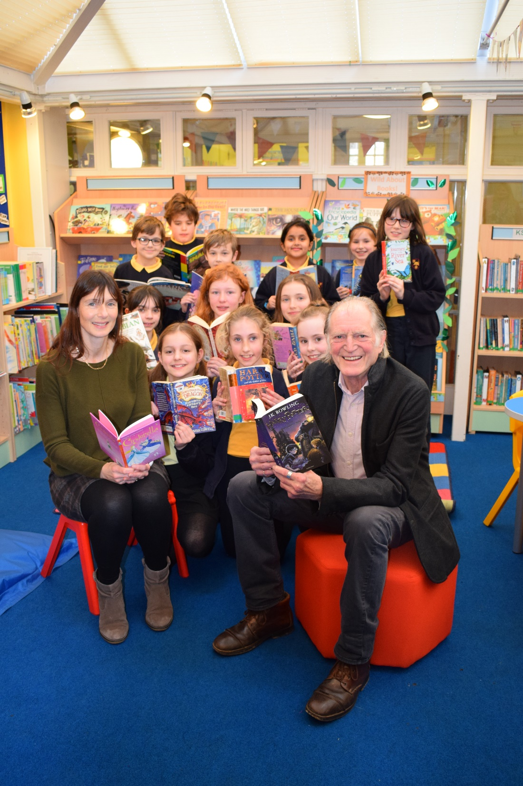

Slide 14
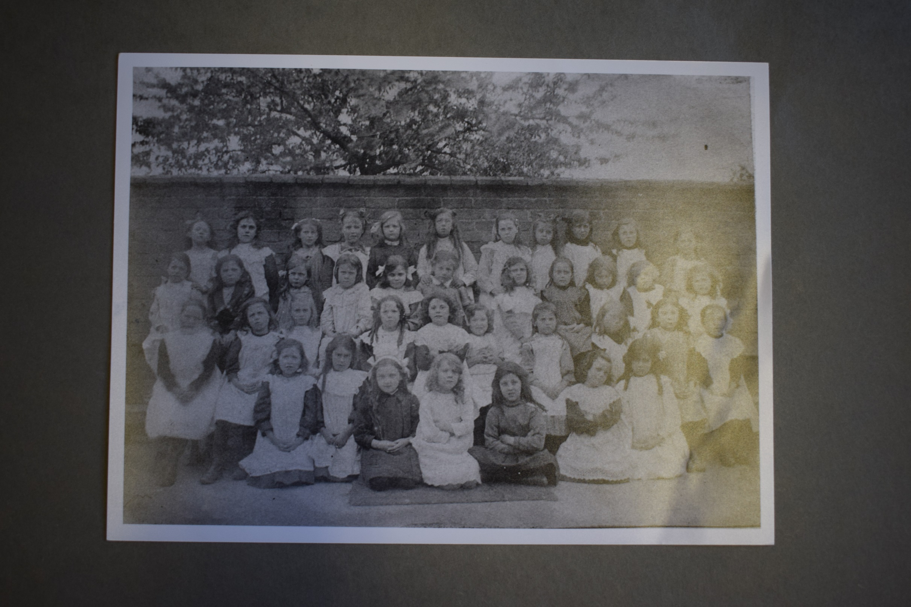

Slide 15
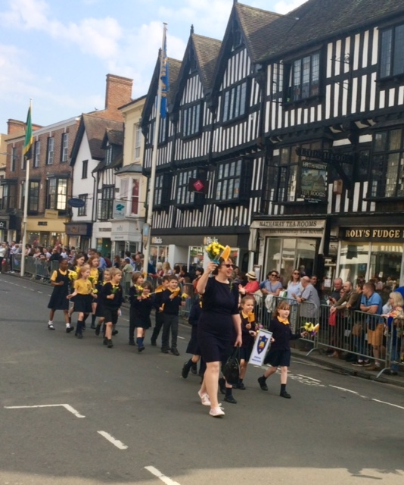

Slide 16
Sing Happy Birthday to our school and of course ‘We are the children of Stratford School’

