Slide 1

Year One
Welcome to
2024-25

Slide 2
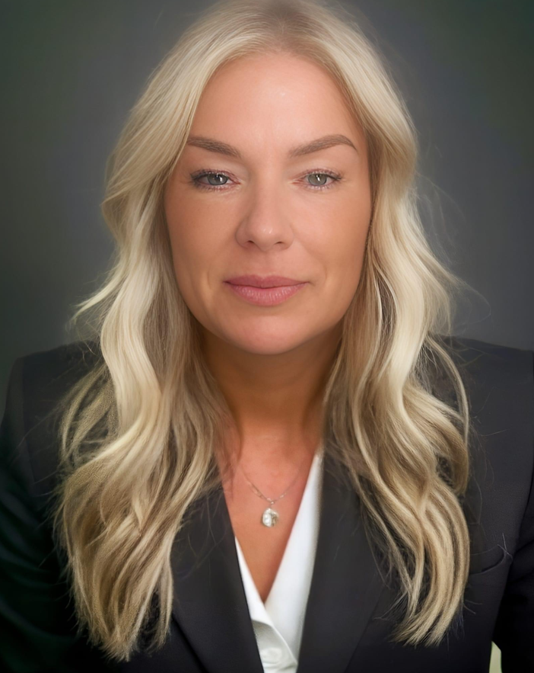
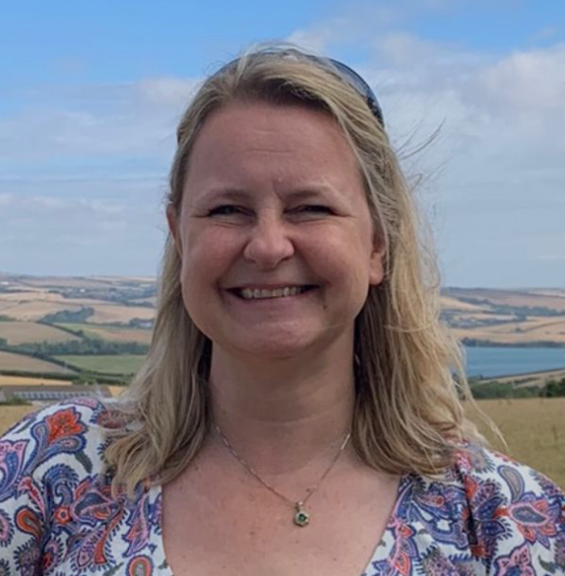
Year 1 Staff
Teachers
Miss Rushton
Miss Parton
PPA cover – Thursday pm
Support Staff
Miss Buchanan
Miss Steel
Mrs. McDonald
Monday, Tuesday, Thursday, Friday - full days
Monday to Friday - mornings
Wednesday - Friday

Slide 3
School starts at 8:45am. A typical day in Year 1 is fast paced and action packed!
Children arrive at school, put their belongings away on their pegs and settle down quietly to complete their early morning activities during registration time. They then move straight into morning lessons, which are the core subjects: Phonics, English and Maths. There are also enhanced provisions in place during these lessons.
The afternoon runs similarly to the morning, with Topic based learning. The children will have an afternoon starter, these are either spellings, number bonds or phonics recap or mastering number. They then move into the foundation subjects. Continuous provisions are running along side teacher lead activities.
Towards the end of the day the children have story and song time.
Throughout the week, the children have daily handwriting practice, whole class/ guided reading, reading with an adult.
A Typical Day in Year 1

Slide 4
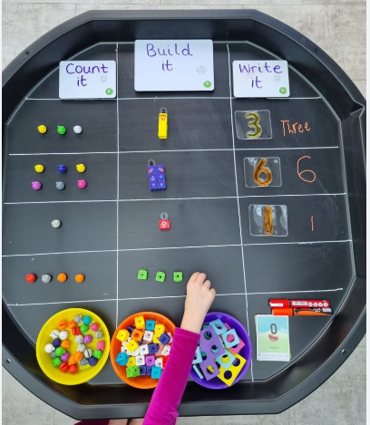
Learning through Play
Continuous provision
In Year 1 we have a heavy focus on learning through play. This allows the children to develop their independence, resilience, and determination as well as covering all areas of the curriculum.
The classroom is set up with lots of resources that the children can access to facilitate their learning.
Each week the children have independent challenges to complete. These challenges are linked to our topic.
As well as completing the challenges the children will also complete set work with adult support. For example, after a Maths lesson the children will work with an adult to complete an activity linked to the lesson. This is done in groups and one to one.

Slide 5
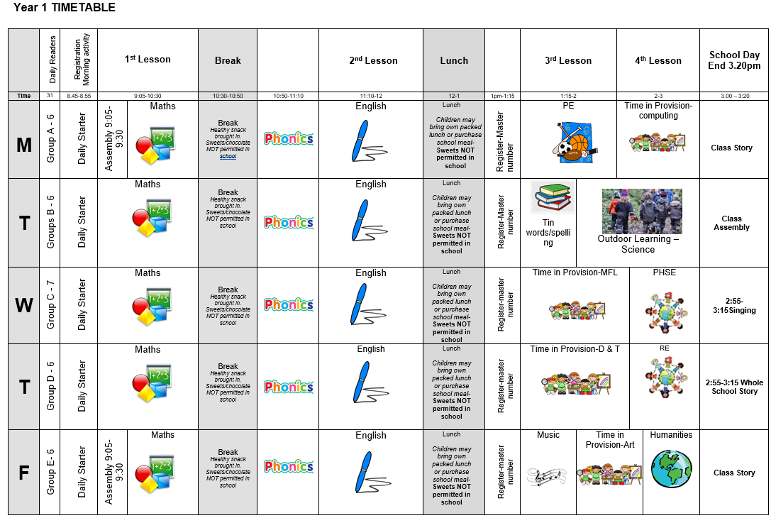
Class Timetable

Slide 6

PE and Outdoor Learning
Our PE lessons is on Monday. Children should come to school in their PE kits.
Our outdoor learning sessions will be on Tuesday afternoons. The children will start the term using the outdoor space. This will sometimes be whole class, half the class or small groups.
Please ensure every item is clearly named!

Slide 7
How we assess the children
Assessment in KS1 is carried out daily, using live marking and targeted questioning as the children are working. This is to ensure that feedback is immediate, and children can respond immediately, ensuring the misconceptions are quickly addressed. Observations will take place and be recorded on Tapestry.
Children will then have differentiated work and adaptations to suit their ability or need.
Throughout the year, children will take part in assessments in reading, writing and mathematics to inform us of next steps; gaps in learning etc.
Children will be assessed in phonics in Year 1 in June. This is a check where the children have to read real and nonsense (alien) words. E.g. wup
It is completed in a relaxed and informal way. Children are not made aware that it is a formal assessment.
The Statutory Assessment does not make up the whole picture. We use teacher assessment to make a final judgement on whether children have met the Expected Standard for the end of Year 1.

Slide 8
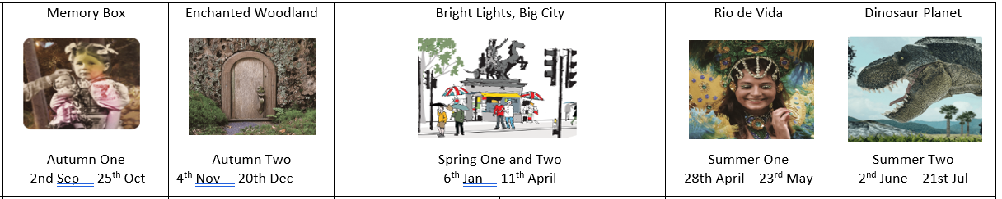
Curriculum
Each term Year 1 will have a new learning topic and key text

Slide 9
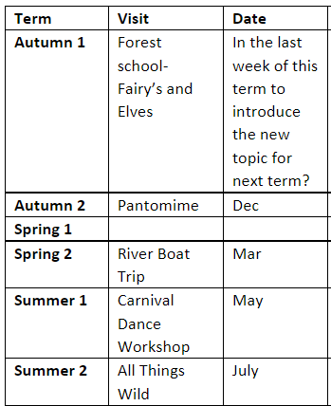
Educational Visits

Slide 10
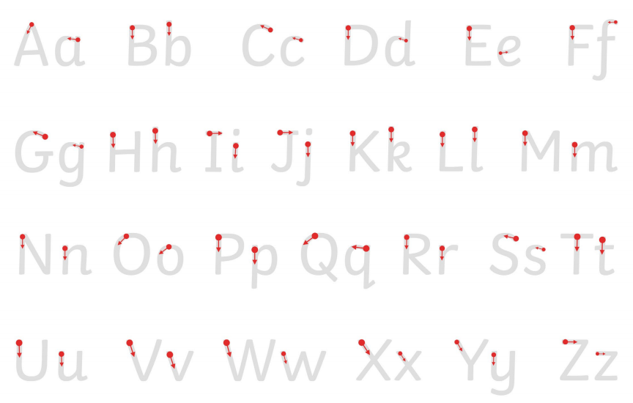
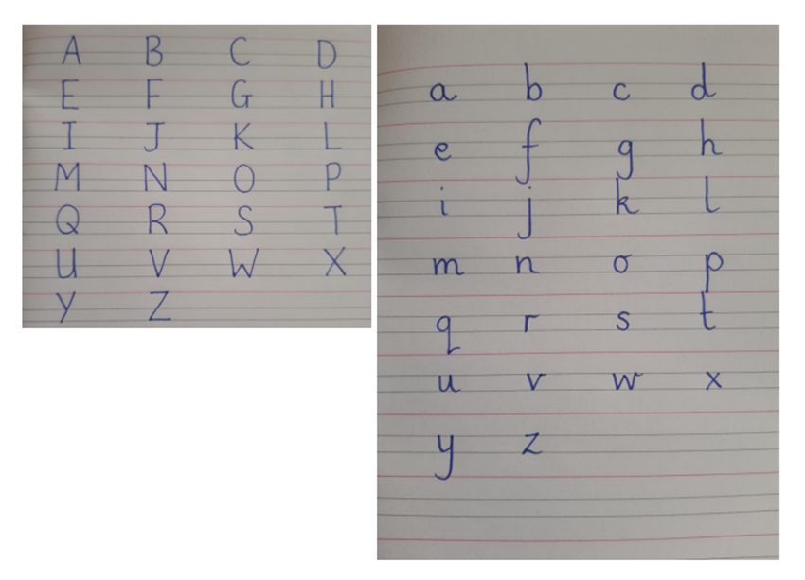
Homework
Reading- Please read with your child daily, books and reading records need to be in school every day! Books are changed on Mondays or Tuesdays. The children will come home with a book linked to Phonics sounds. Children will read at least three times a week in school.
Phonics- Daily practice in school. Links have been added to the next page to support parents teaching at home.
Maths- White Rose Maths One Minute Maths, KIRFs, Number formation.
Spelling- Each week the children will be given 5 tricky words to learn. These will come home in small folders. New words will be added once they can read, spell and write the word.
Writing- Below is an example of letter formation. When completing work with your child at home please help them to form their letters correctly; including starting and ending them in the right place. There is a link to a video to support the correct formation at home. Children will complete letter formation and handwriting two times a week.

Slide 11
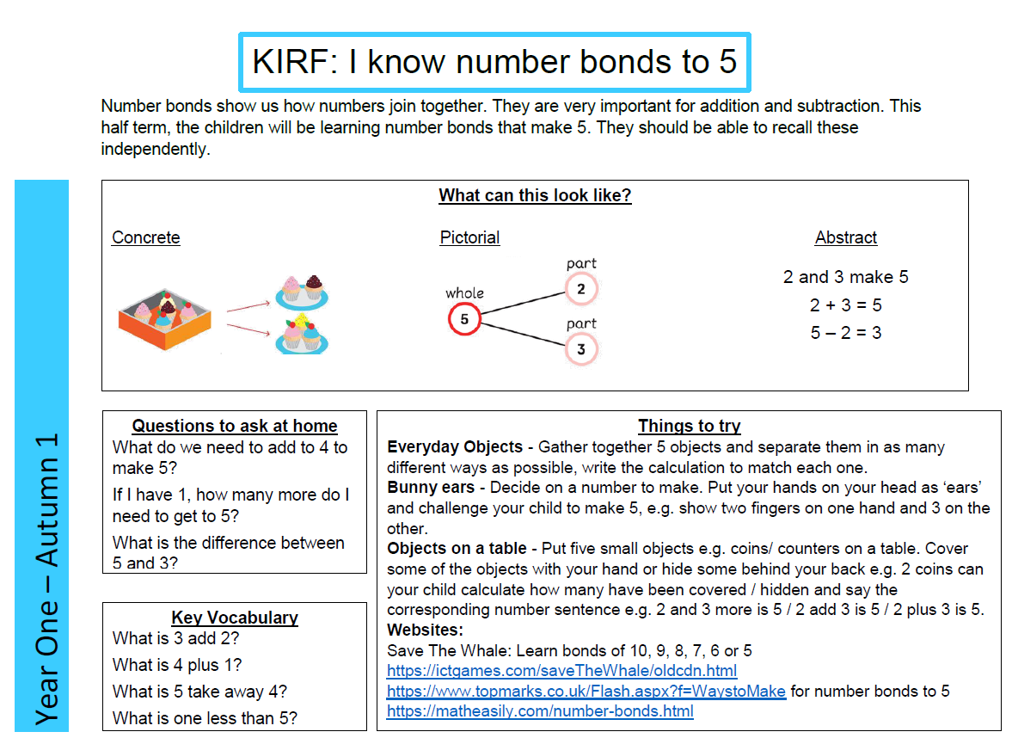
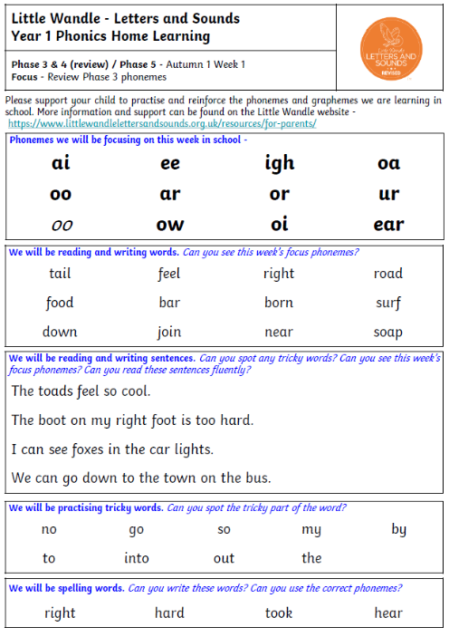
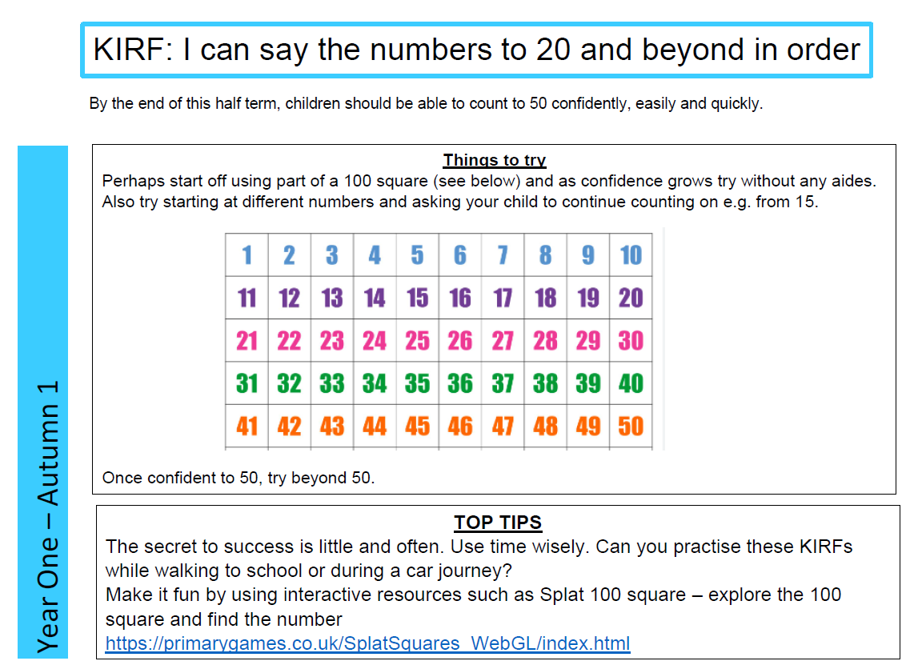
Homework
Phonics –
A paper copy will be sent home every Wednesday and you can also find on class Dojo.

Slide 12
Reading books
Reading books will be changed on a Monday.
Your child will not be given a new reading book until they have returned the previous one.
If a book is damaged or not returned to school then you will need to replace it.
They can be purchased from Amazon for approximately £5.

Slide 13

Phase 2 sounds- single sound https://www.youtube.com/watch_popup?v=-ZtjFIvA_fs
Phase 2 sounds https://www.youtube.com/watch_popup?v=qDu3JAjf-U0
Phase 3 sounds https://www.youtube.com/watch_popup?v=DvOuc7cWXxc
Tricky Words https://www.youtube.com/watch_popup?v=3C1KTDag0ZA
Parent Phonics Page https://www.littlewandlelettersandsounds.org.uk/resources/for-parents/
Letter formation https://www.youtube.com/watch_popup?v=2a_e2z78xM4&list=PLGCpNseRUqM4DZKJwKPKmRxTc0lsP0l47
Maths App https://whiteroseeducation.com/1-minute-maths
Parent Links

Slide 14
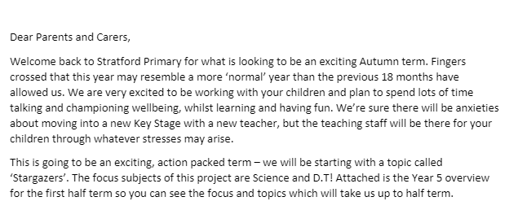

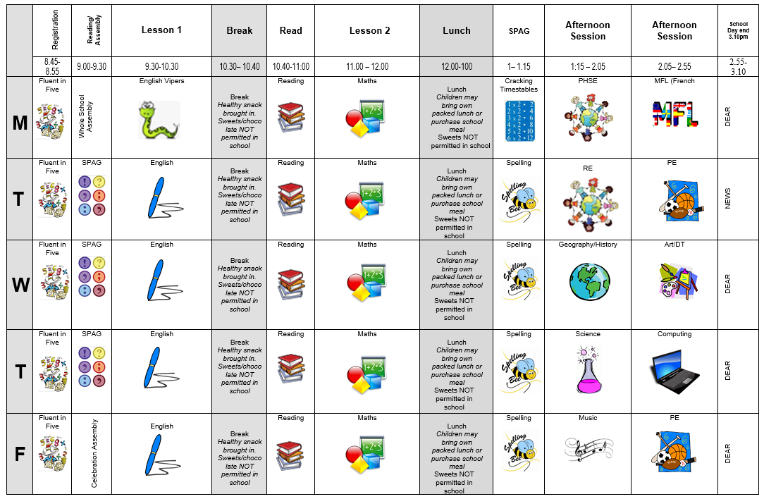
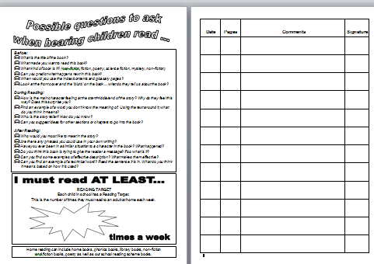
Communication
Parent letter
Weekly News Letter​
Timetable​
Reading diary ​

Slide 15
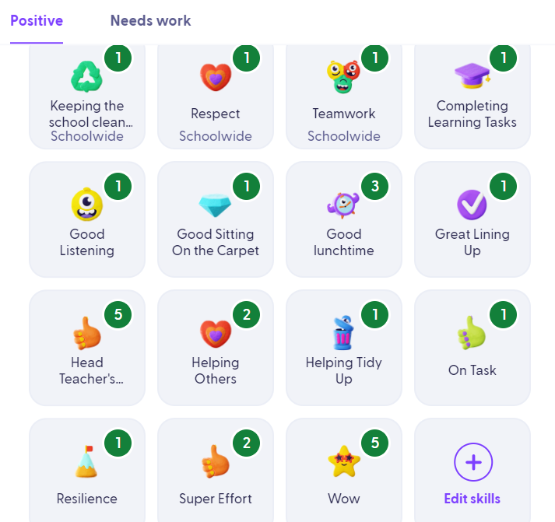
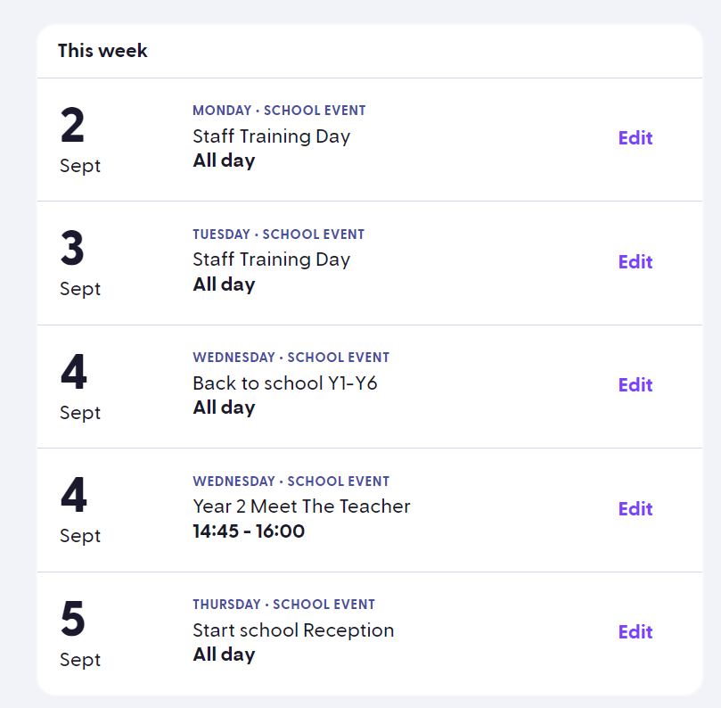
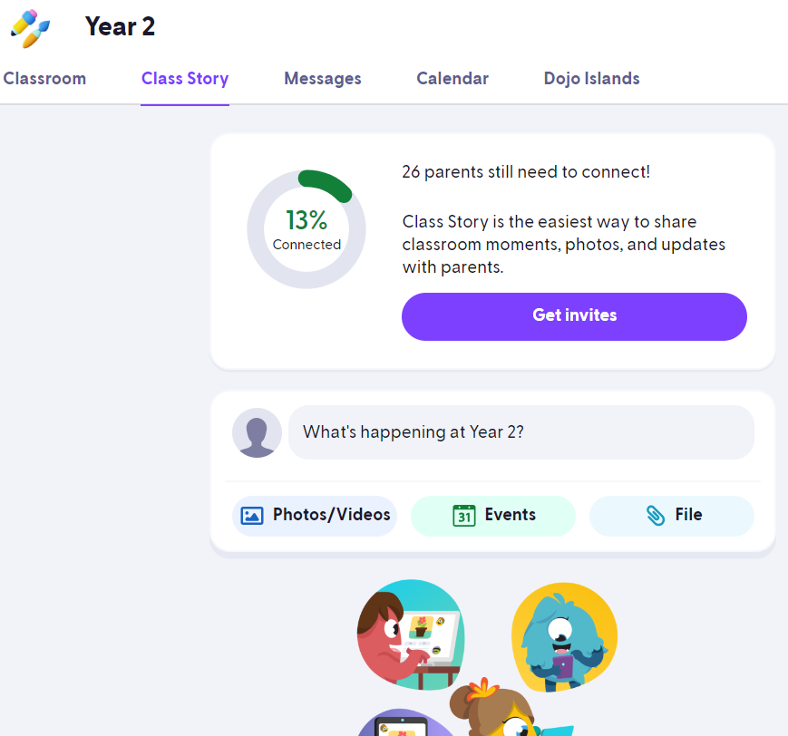
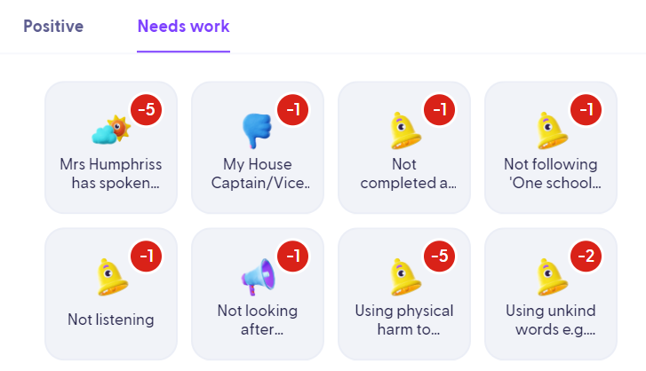
Class dojo

Slide 16
Communication
We are always here to support and listen. You may come and talk to us at the end of the school day. If it is urgent, please email the school office.
​
If you have any minor inquiries, such as lost items/afterschool clubs, you can contact us via the school office.
Important issues can be spoken about in person and appointments with teachers can be done via the school office to the attention of Miss Rushton.
​
​Serious injuries will be either a phone call home or a face-to-face chat. Minor injuries such as cuts and grazes will be communicated via accident forms which are given out at the end of the day.​​
.

Slide 17
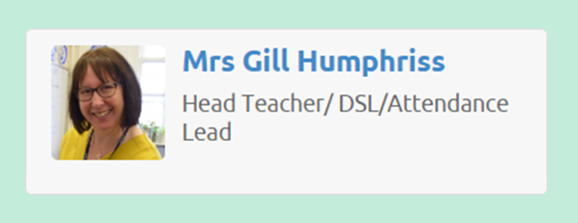
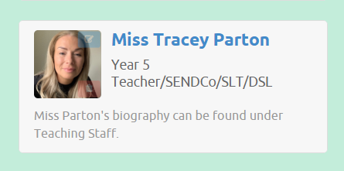
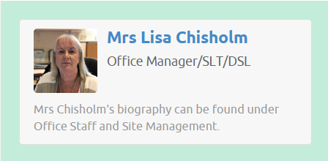
Additional Support/Concerns…
If you have any concerns about your child or need our support, you can directly come and talk to me after school. You may want to contact the school office and arrange a meeting in private.
The DSL team are always welcoming and can support you with your concerns.
You can email or phone - more contact information is available on the website.​
​

Slide 18


Expectations
Behaviour – high expectations, in class, in the playground, moving around school, on educational visits, when visitors are in and during after school clubs.
School uniform / PE kit / Lost Property – LABEL!
Presentation, in school and when completing work.
Encourage independence – children to inform when they need a book changed, need to hand in a letter, bring sheets and uniform home, hand homework in.
Named water bottle needs to be in school every day.
Phone or email the school office of your child is absent.

Slide 19
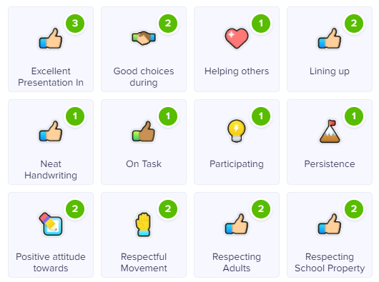


Celebrating Success…
Well-being Warrior in celebration assembly
Topic Sharing Events/Writer of the month
Looking at the website and Class Dojo
Stickers, Dojo points, House Points, and ‘WoW’ board

Slide 20
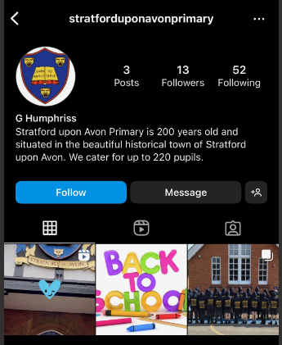
AOB…
​
Healthy snacks for break and in lunches - no nuts
Clearly label: uniforms, coats, shoes and bags​
PE is on a Monday- Please send them to school in PE kits
Only Prescribed medication -should be clearly labelled and taken to the office-not in school bags​
All families to be on Class Dojo ​for all communication.
Follow us on Instagram… stratforduponavonprimary
​
RESPECT – the one school rule ​
​

