Slide 1

TRUE FRIENDS

Slide 2
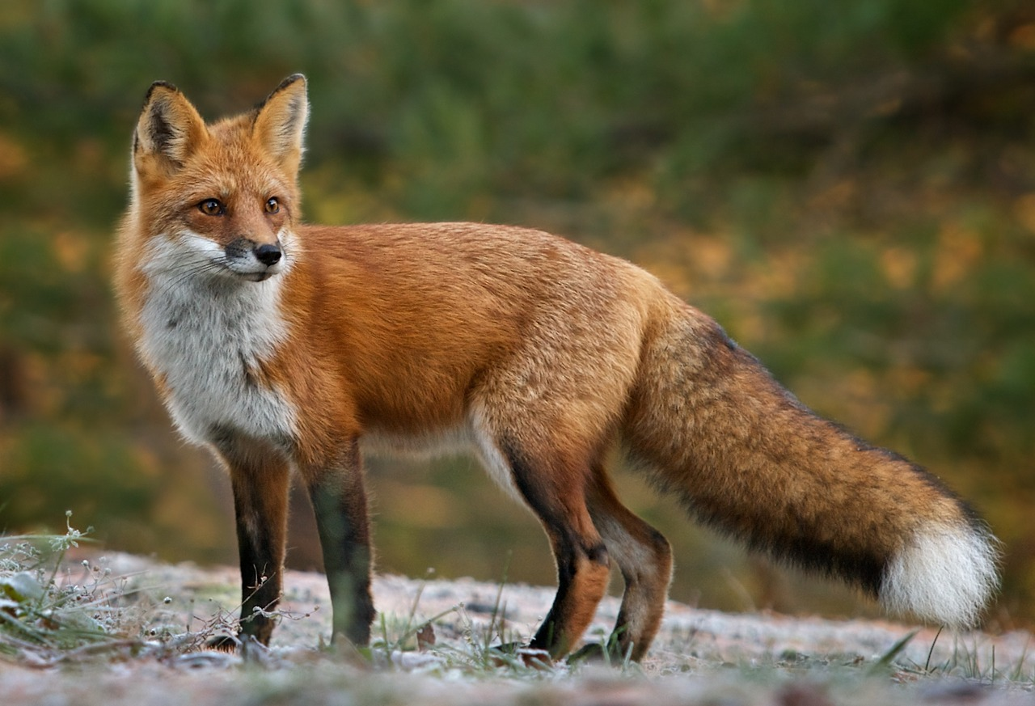
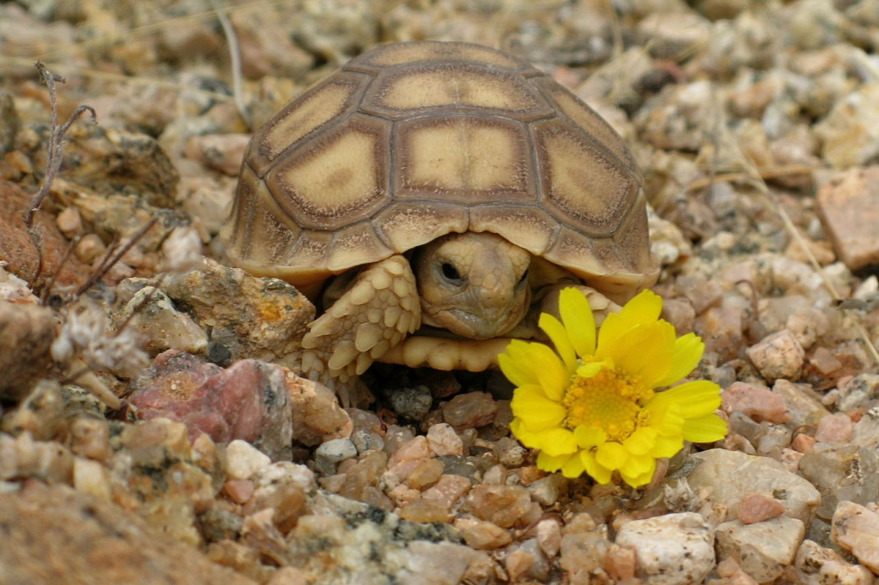
The Fox and The Tortoise

Slide 3

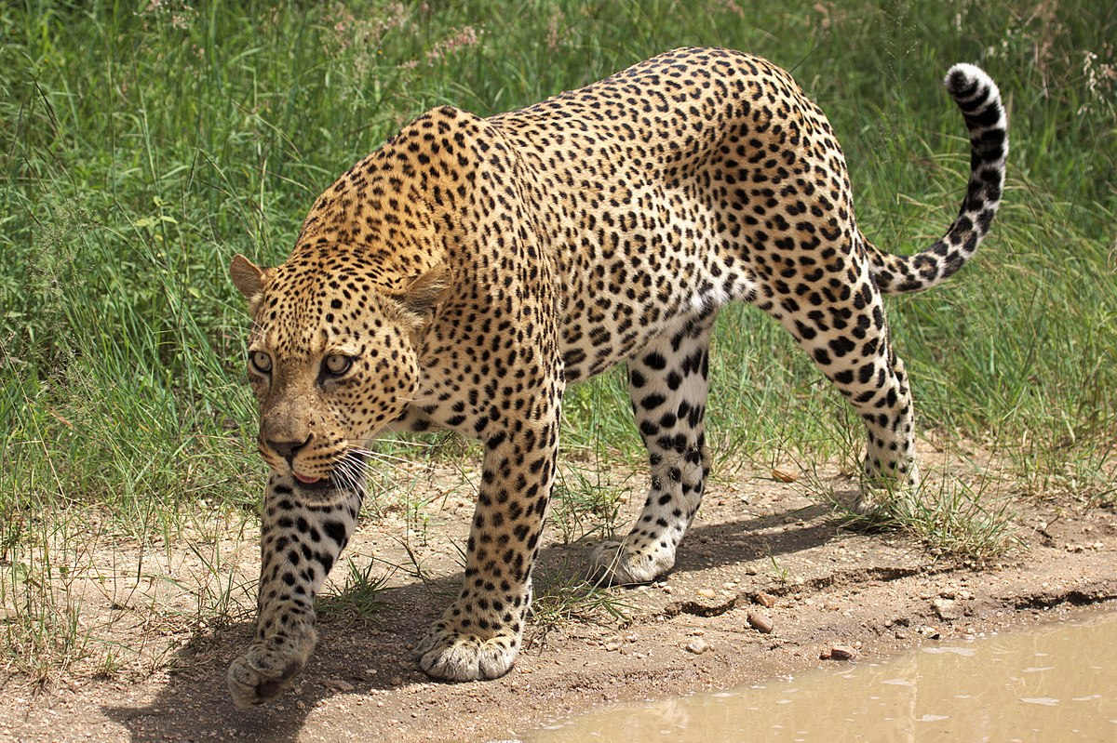

Slide 4



Slide 5


Slide 6
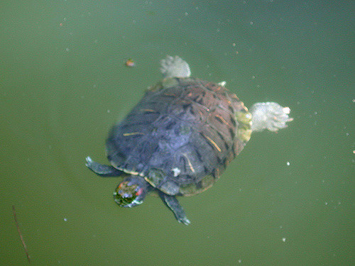

Slide 7
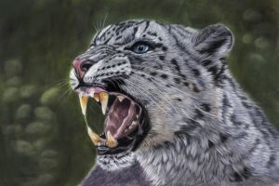

Slide 8



Slide 9
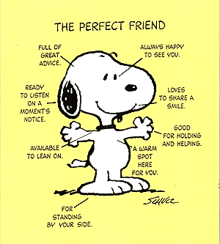
Be a friend – don’t be a bystander!

Slide 10


STOP IT PLEASE
Say the behaviour you want to stop
For example – ‘Stop it please you are too loud it makes me feel unsafe’
Only need to say once or twice
If behaviour carries on – seek help

Slide 11
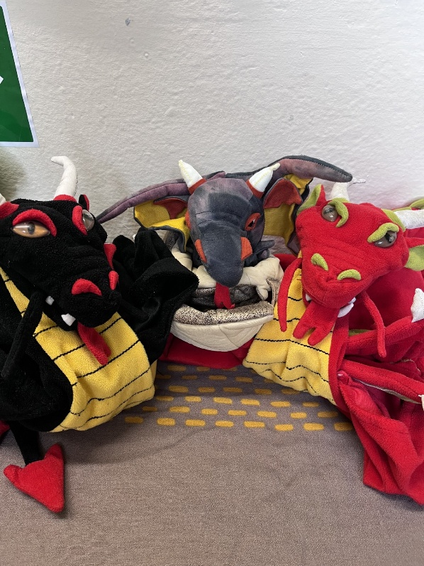

Attendance
Dragons go to Y6, Y4 and Y2
Reception 95.8%
Year One 88.3%
Year Two 99.2%
Year Three 98.4%
Year Four 100%
Year Five 95.3%
Year Six 100%
Whole School 96.8%

Slide 12

Sing

