Slide 1

Welcome to Year 1!
Ms Desai, Mrs Green, Miss Buchanan & Mr Kelly

Slide 2
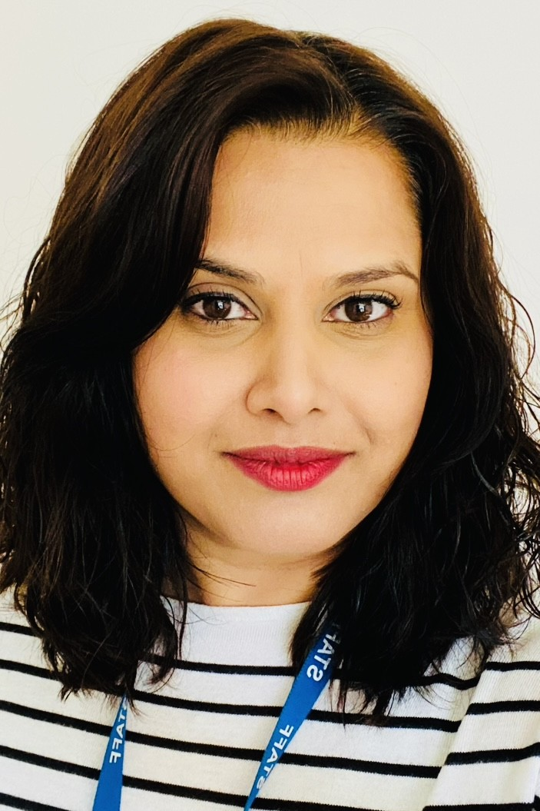
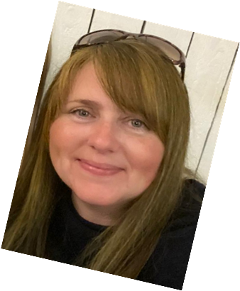
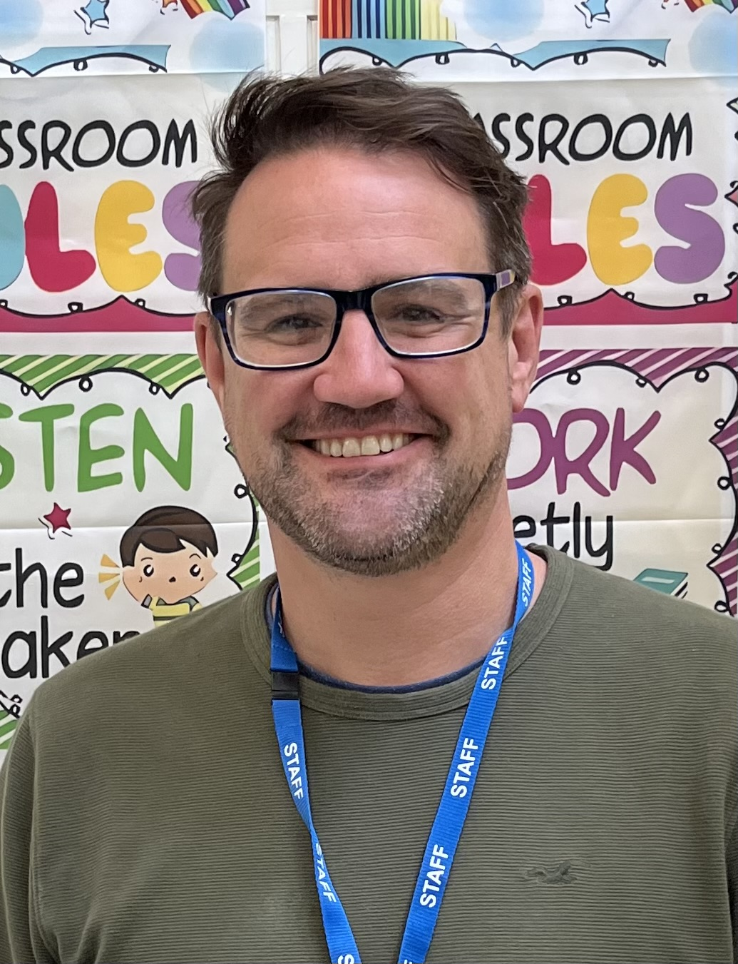
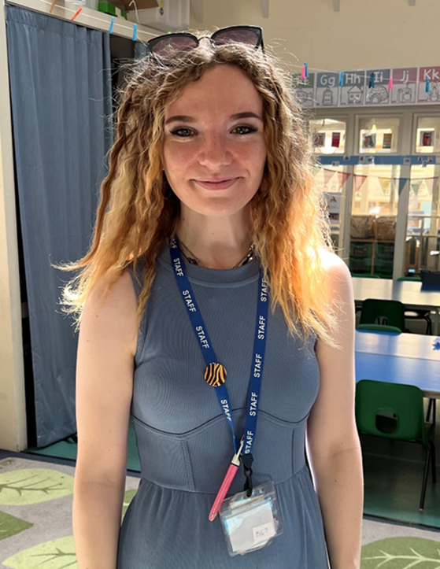
Meet the teacher Ms Desai
Welcome to Year 1!
I am Ms Desai and I am the Year 1 teacher supported by Mrs Green (am) & Miss Buchanan (pm). Mr Kelly will also be teaching one day per fortnight

Slide 3
A Typical Day in Year 1…
Year 1 is exciting and action-packed with many thrilling learning adventures along the way!
A typical day begins with the gate opening at 8.40 am. Children enter school via the KS1 door, with school officially starting at 8.55 am - all children are expected to be in class for registration. Upon arrival, book bags are placed in the drawers outside Year 1 and coats on named pegs. The children will begin the day with an early morning activity during registration time.
Children will then move straight into morning lessons of maths, phonics and English. Enhanced provisions will also be in place during these lessons to support learning. The afternoon runs similarly to the morning, with theme-based learning.

Slide 4
Afternoon
The afternoon starter focuses on Mastering Maths. Children will then move into the foundation subjects. Continuous provisions will run alongside teacher-led activities.
Towards the end of the day, we will read a story and sing! Throughout the week, the children have daily handwriting practice and whole class/ guided reading.​

Slide 5
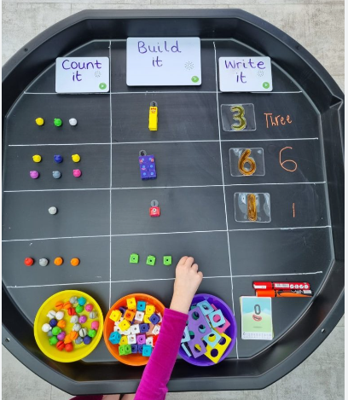
Learning through play
Continuous provision
In Year 1, there is a focus on learning through play. This allows the children to develop their independence, resilience, and determination, whilst covering all areas of the curriculum. The classroom is set up with a variety of resources that the children can access to facilitate their learning.
Each week, the children will have independent challenges to complete. These challenges are linked to the teacher-led input and theme. In addition to the challenges, children will also complete learning tasks with adult support..

Slide 6
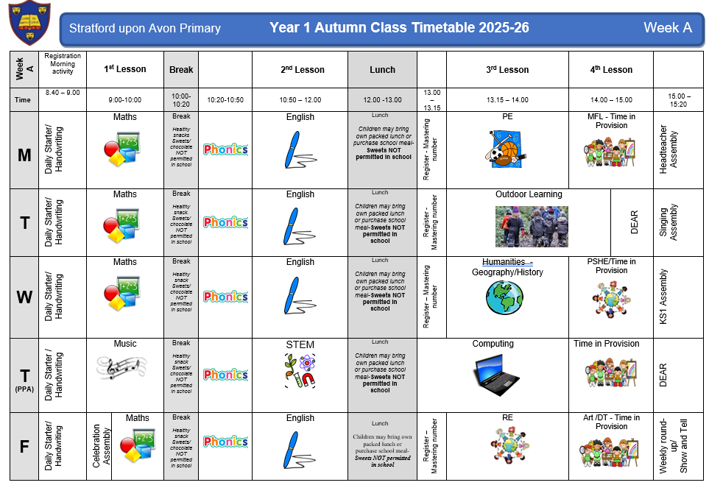
Weekly timetable

Slide 7
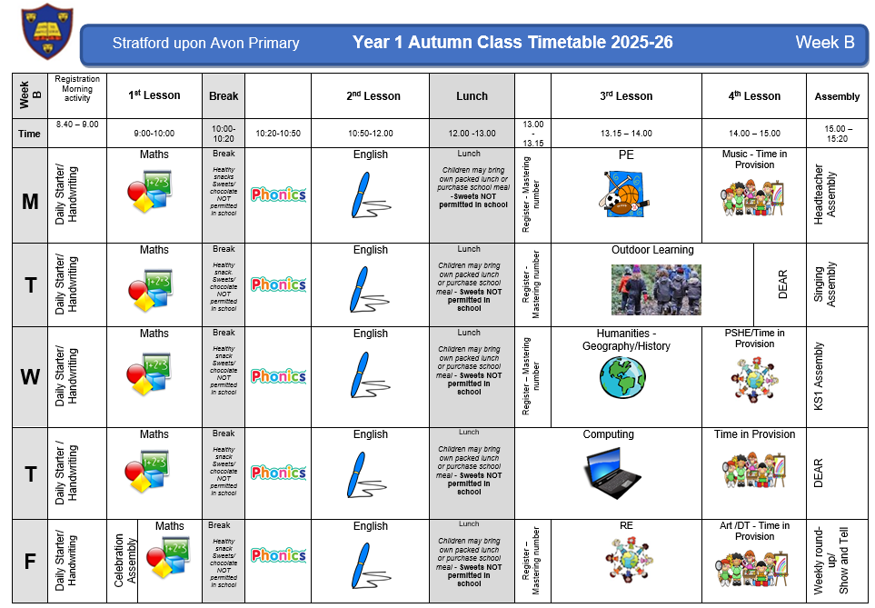
Weekly timetable

Slide 8
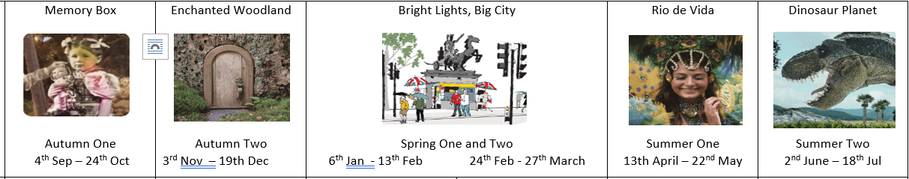

Year 1’s Creative Learning Themes and Texts for 2025-2026

Slide 9
Maths – Scheme of learning
Autumn
Place Value
Addition and Subtraction
Shape
Spring
Place Value
Addition and Subtraction
Place Value
Length & Perimeter
Mass & Volume
Summer
Multiplication & Division
Fractions
Position & Direction
Place Value
Money
Time
Maths Mastery deepens children’s mathematical understanding and knowledge, providing meaningful opportunities to apply learnt skills.

Slide 10
Topic Learning
In addition to the morning core subjects, children will learn about science through outdoor learning. The foundation subjects - including geography, history, French, ICT, RE, PSHE, music and art/DT – are linked to each term’s theme of learning, incorporating cross-curriculum teaching wherever possible.

Slide 11
PE and Outdoor Learning
Year 1 PE lessons are on Monday. Please ensure children come to school dressed in PE kits.​ Suitable trainers will be needed.
​Our outdoor learning sessions will be on Tuesday afternoons which will mainly take place in the paddock. Children will need long trousers and sleeves all year for paddock days. They will also need appropriate shoes such as wellies, and waterproof coat and trousers. ​
​
PLEA: Please ensure every item is clearly named!

Slide 12
Trips & Visitors...
To further enhance the curriculum and children’s class based education, we have planned trips and experiences that will captivate and stimulate the intrinsic learning.
The planned events for the year are…
Author visit – 22nd October
Author visit – 19th November
Year 1/2 Christmas Play – 10th December
Puppet theatre visitor – 18th December
Science Fair – 13th March
Out and about: Shakespeare Week – 24th March
Shakespeare Trail – 27th March
Carnival Day – TBC
All Things Wild - TBC

Slide 13
Assessment…
Consistent assessment is conducted daily, with live marking and targeted questioning as the children are working. This enables purposeful and effective feedback that addresses any misconceptions or specific knowledge gaps.
Throughout the year, children will undertake termly assessments in reading/phonics, writing and mathematics to inform the teaching team of next steps to support learning.
In June, Children will be assessed in phonics as part of the national screening assessment. This is a check where the children have to read real and nonsense (alien) words. E.g. wup.. Children are not made aware that it is a formal assessment as it is delivered informally.
The Statutory Assessment does not make up the whole picture. We use teacher assessment to make a final judgement on whether children have met the Expected Standard for the end of Year 1.

Slide 14
Home Learning…
Reading- Please read with your child daily, books and reading records need to be in school every day! Books are changed on Fridays. The children will come home with a book linked to Phonics sounds and a book for pleasure. Children will read at least three times a week in school.
Phonics- Daily practice in school. Links have been added to the next page to support parents teaching at home.
Maths- White Rose Maths One Minute Maths, KIRFs, Number formation.
Spelling- Each week, the children will be given 5 tricky words to learn. These will come home in small folders. New words will be added once they can read, spell and write the word.
Writing- Below is an example of letter formation. When completing work with your child at home please help them to form their letters correctly; including starting and ending them in the right place. There is a link to a video to support the correct formation at home. Children will frequently complete letter formation and handwriting during the school week .
.

Slide 15
Phase 2 sounds- single sound
https://www.youtube.com/watch_popup?v=-ZtjFIvA_fs
Phase 2 sounds
https://www.youtube.com/watch_popup?v=qDu3JAjf-U0
Phase 3 sounds
https://www.youtube.com/watch_popup?v=DvOuc7cWXxc
Tricky Words
https://www.youtube.com/watch_popup?v=3C1KTDag0ZA
Parent Phonics Page
https://www.littlewandlelettersandsounds.org.uk/resources/for-parents/
Letter formation
https://www.youtube.com/watch_popup?v=2a_e2z78xM4&list=PLGCpNseRUqM4DZKJwKPKmRxTc0lsP0l47
Maths App
https://whiteroseeducation.com/1-minute-maths

Slide 16

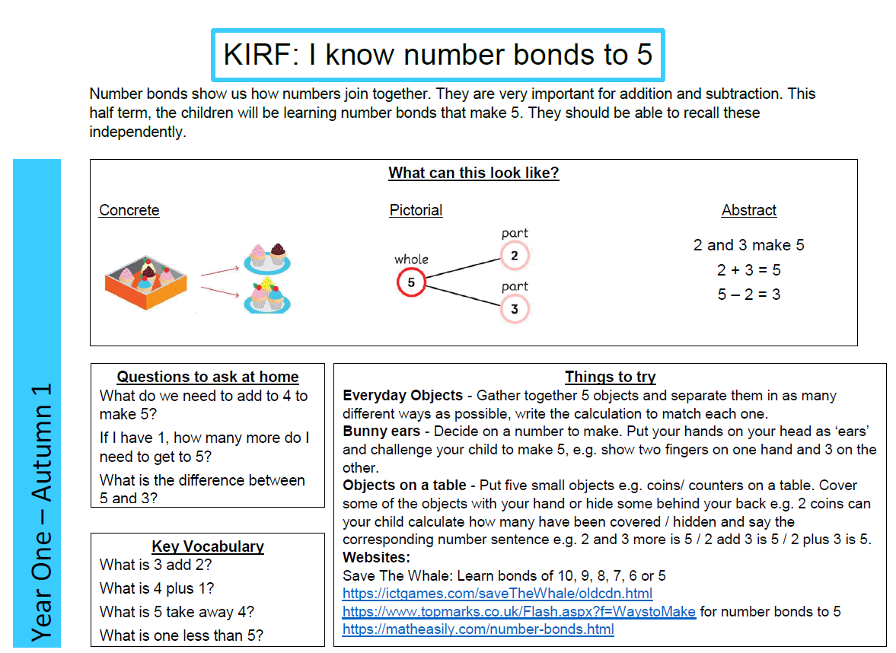
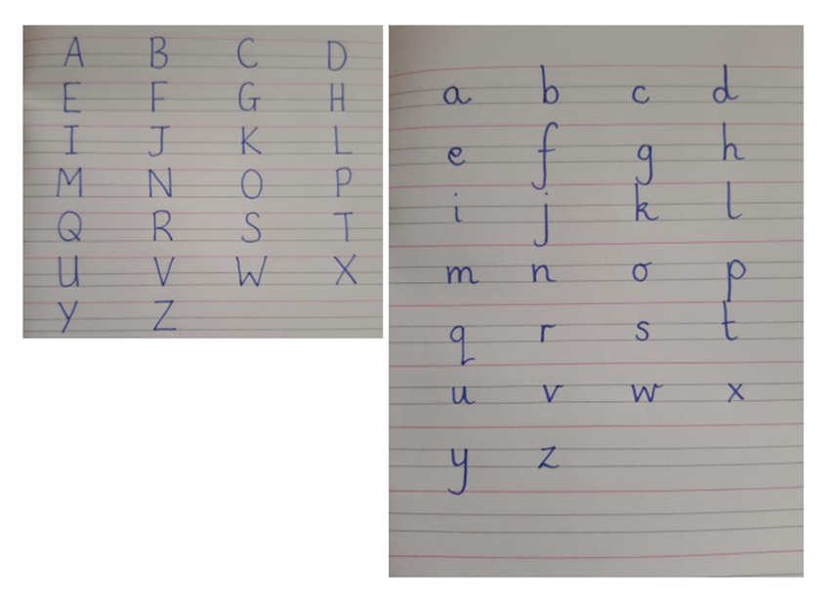
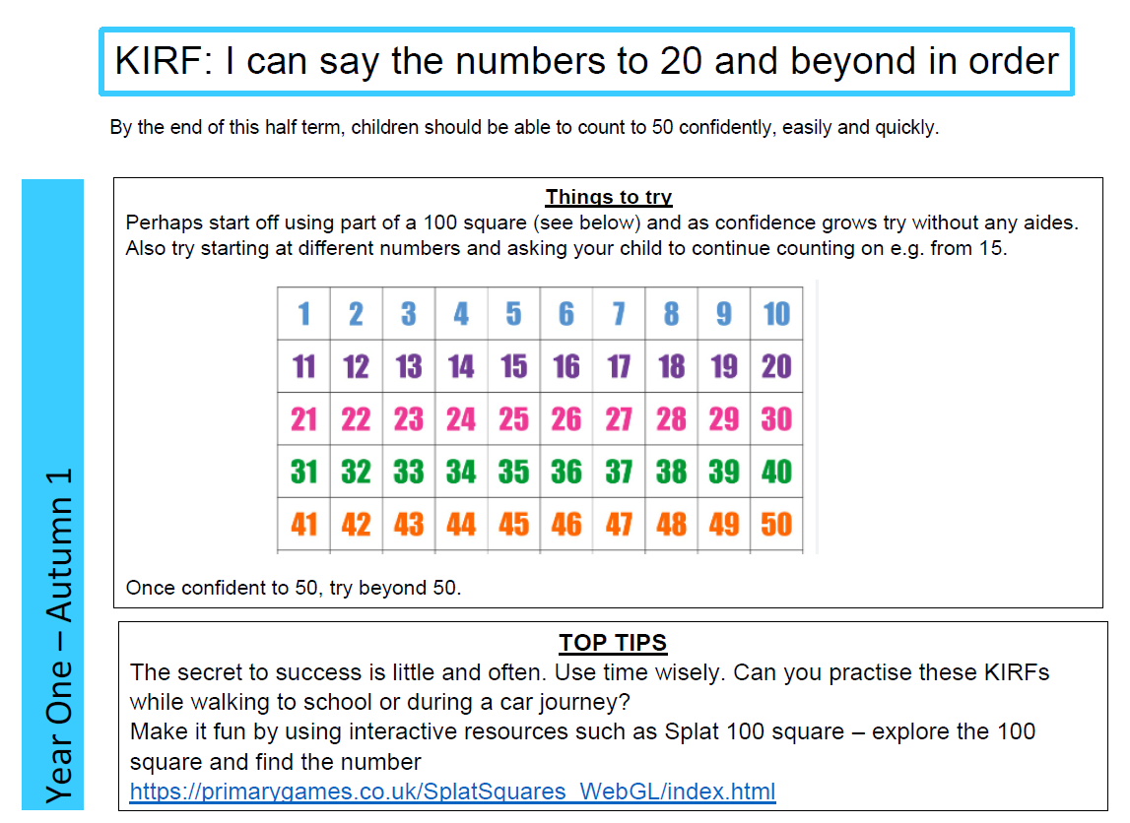
.

Slide 17
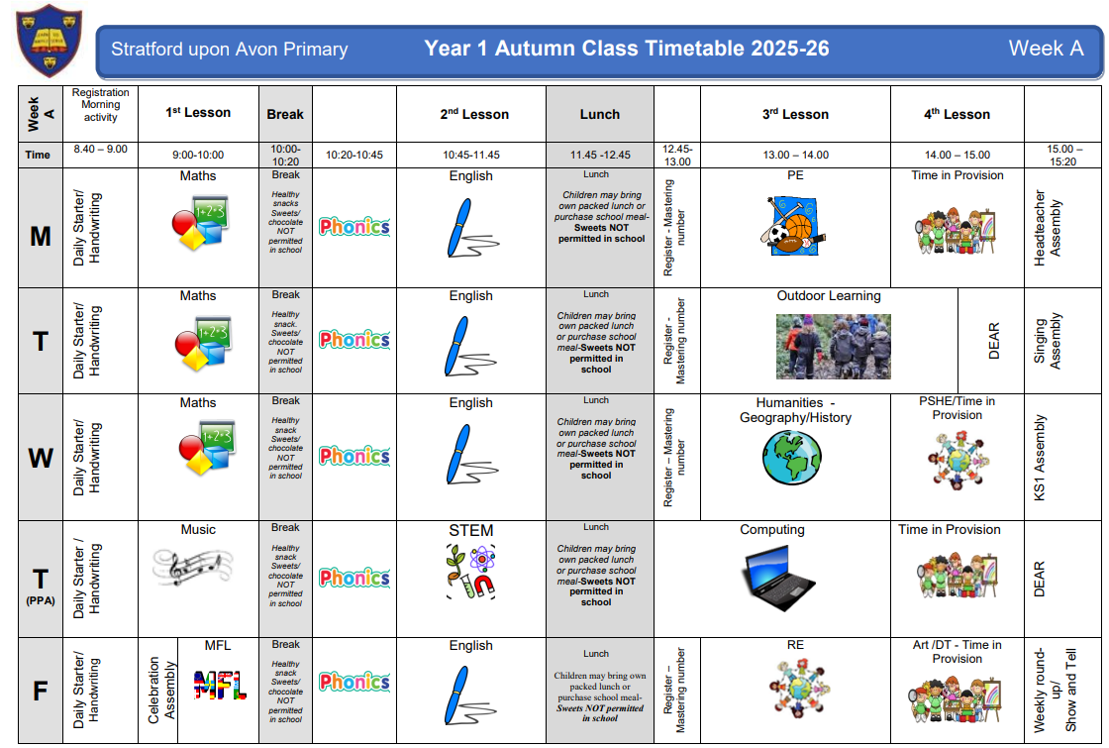
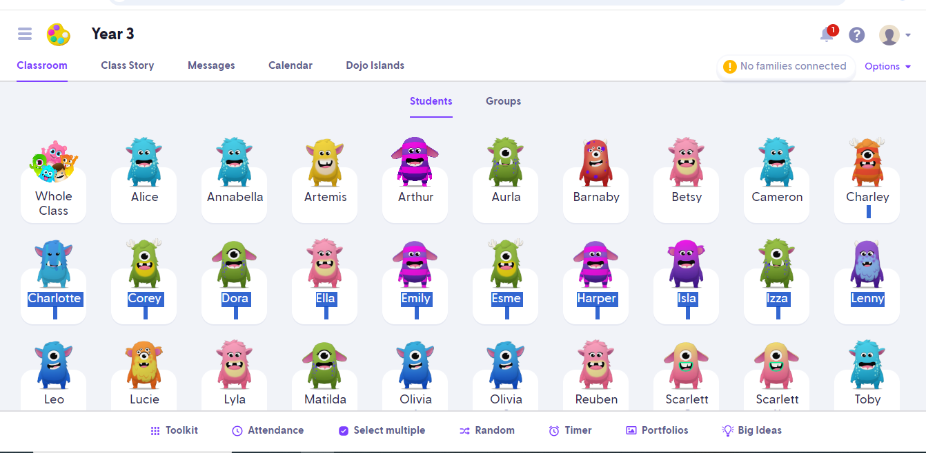

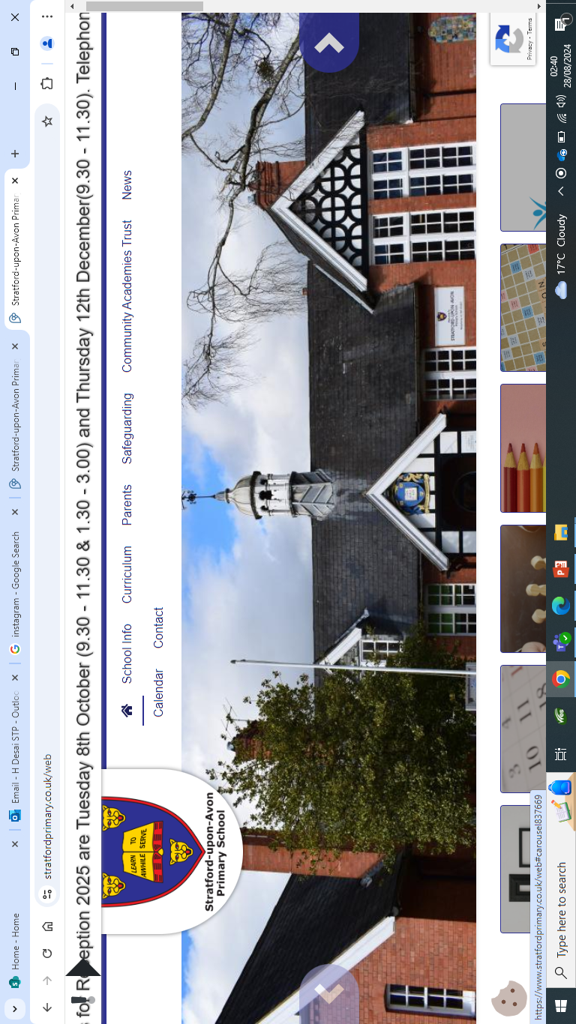
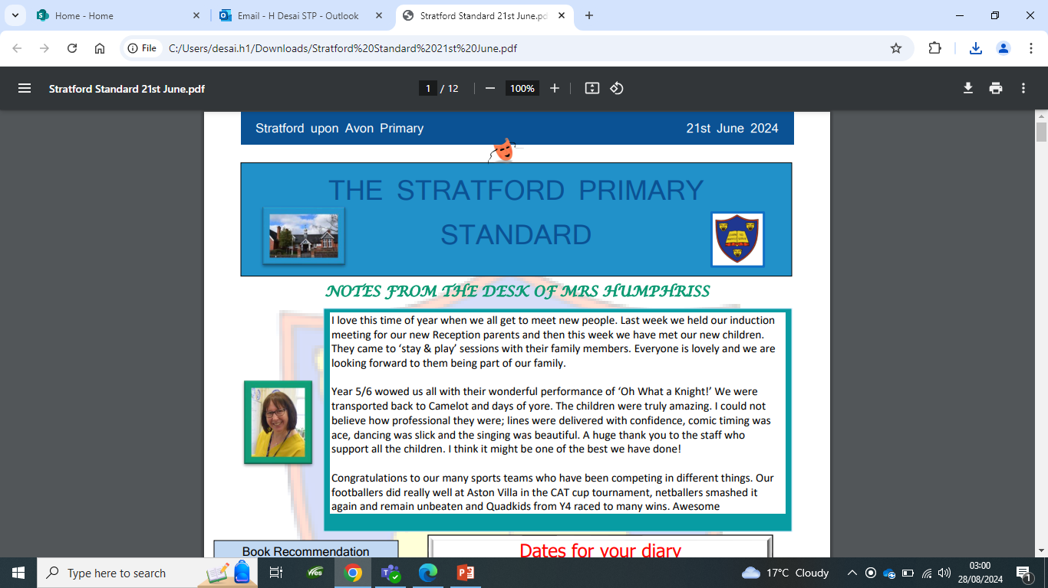
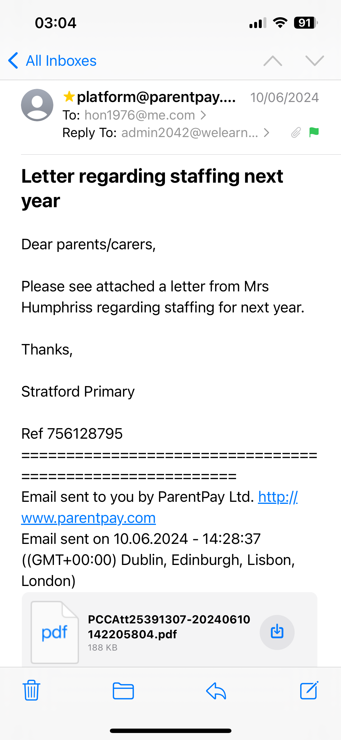
Communication…
Timetable
ClassDojo
Instagram - stratforduponavonprimary
Website
Newsletter
Emails

Slide 18
Communication…
We are always here to support and listen!
You will receive communication via parent letters, emails, weekly newsletter, ClassDojo (new for this year) and the school website. We will also share Year 1 news via the aforementioned platforms and Instagram!
You can contact me via ClassDojo. We ask all parents to join – it’s free to sign up! If the matter is urgent please email admin2042@welearn365.com and it will be forwarded on to me. Please note staff can only respond to emails/messages between 8am – 5pm (and not during direct teaching time). Do regularly check ClassDojo for general class messages.
You can also talk to the member of staff on the gate in the morning about any general enquiries or seek me out at the end of the day. If you require an appointment to speak to me or any other member of staff, this can be arranged directly at the end of the day or via the school office.
​​Serious injuries will be either a phone call home or a face-to-face chat. Minor injuries such as cuts and grazes will be communicated via accident forms, which are given out at the end of the day.​​​

Slide 19

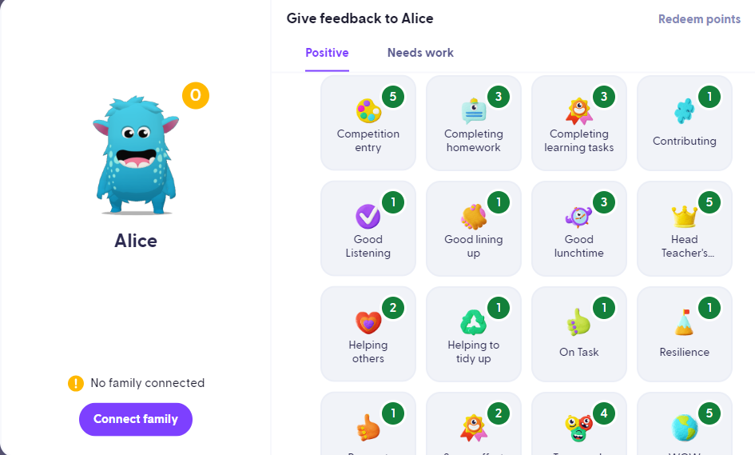
Celebrating Success…
Celebration Assembly: Head Teacher’s Award, Learner of the Week, Well-being Warrior Respect Certificate.
Daily: Affirmations, Stickers, Dojo Points, House Points, Y1 WOW showcase and Year 1 Classdojo recognition
Newsletter, Website and Twitter
Shakespeare Hall Arden Hathaway

Slide 20
Expectations…
Behaviour – high expectations are required: in class, in playground, moving around school, on trips, when visitors are in and at after school clubs . Class contract and One School Rule of RESPECT!
ClassDojo points and house points.
Please clearly label all uniform and personal items and it is the children's responsibility to look after these.
We are proud of our presentation: in school and when completing homework.
Promoting independence: encourage children to organise themselves for a successful day; to inform staff when they need a book changed, need to hand in a letter, bring sheets and uniform home, hand homework in; taking ownership, building greater self-esteem and sense of achievement.
.

Slide 21
Final points of importance…
ParentPay – lunches and trip payments
Medicines – Only prescribed medicines with child’s name are permitted. They must be handed to the office. No medicines should be left in a child’s bag.
School uniform/PE kit/ snack pots should all be clearly labelled and it is the children's responsibility to look after these.
Healthy snacks – NUT FREE! No sweets or chocolate
In accordance to new statutory guidance holidays/leave of absence will NOT be granted except in exceptional circumstances.
RESPECT – the one school rule

Slide 22
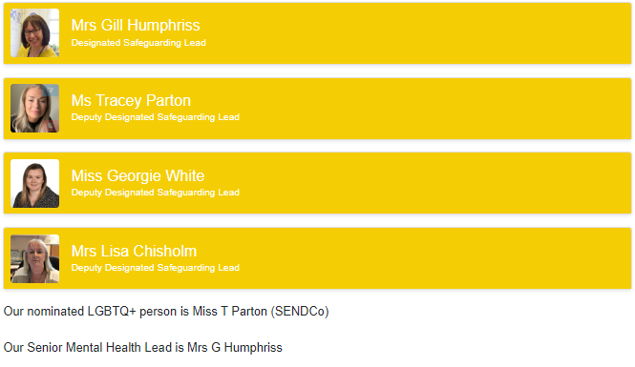
Additional Support/Concerns DSL
The DSL team are always welcoming and can support you with your concerns.​
Please call or email the office to arrange to speak to one of the DSL team

Slide 23
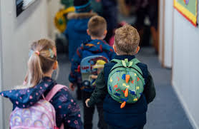
Any Questions?
Thank you!

