Slide 1
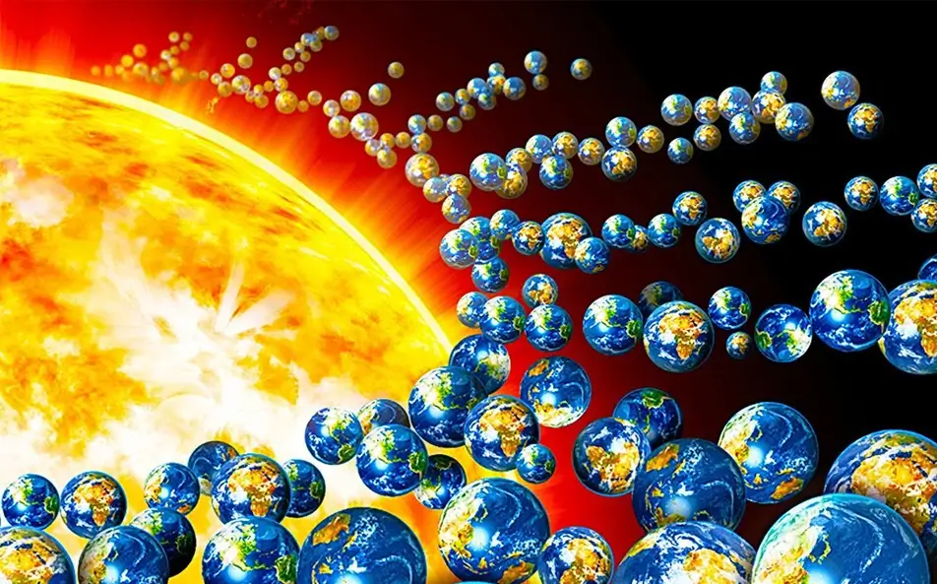
How many earths can you see?

Slide 2
The ozone is a natural sunscreen – without it the sun is damaging.

Slide 3
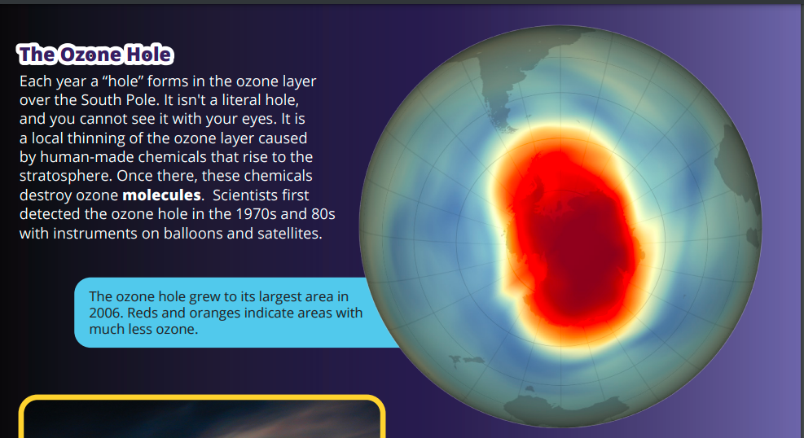

Slide 4
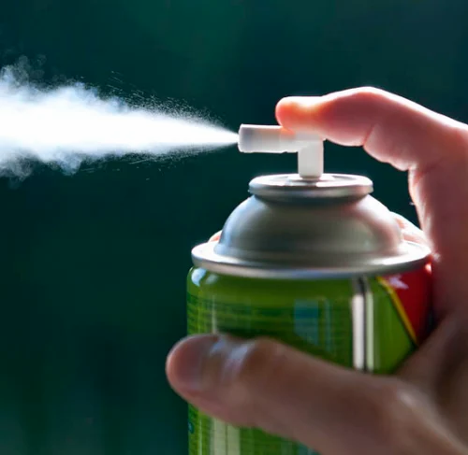
Why does this happen?
Humans caused the damage to our ozone layer.
We invented chlorofluorocarbons (CFCs) and similar chemicals. We then used them in aerosol sprays, foams, air conditioners, and refrigerators.
Unfortunately, these chemicals can accumulate on high clouds in the stratosphere. Then sunlight breaks the CFCs into chlorine atoms that react with ozone and destroy it.

Slide 5
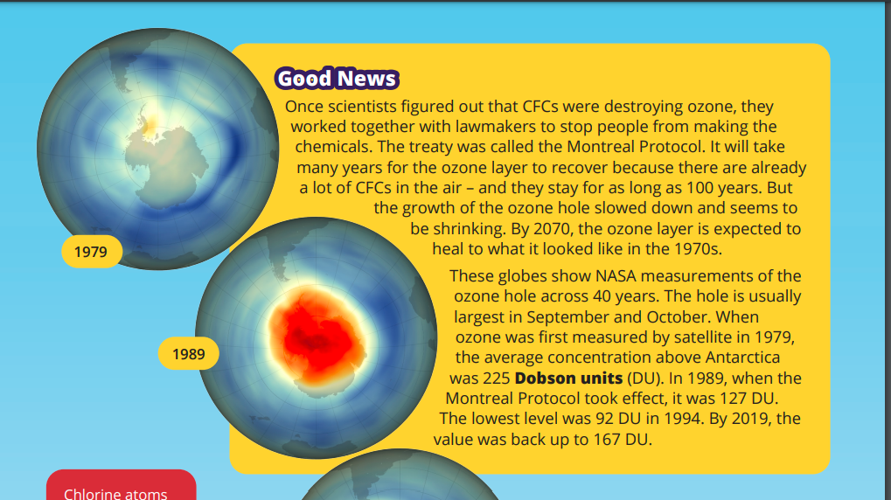

Slide 8
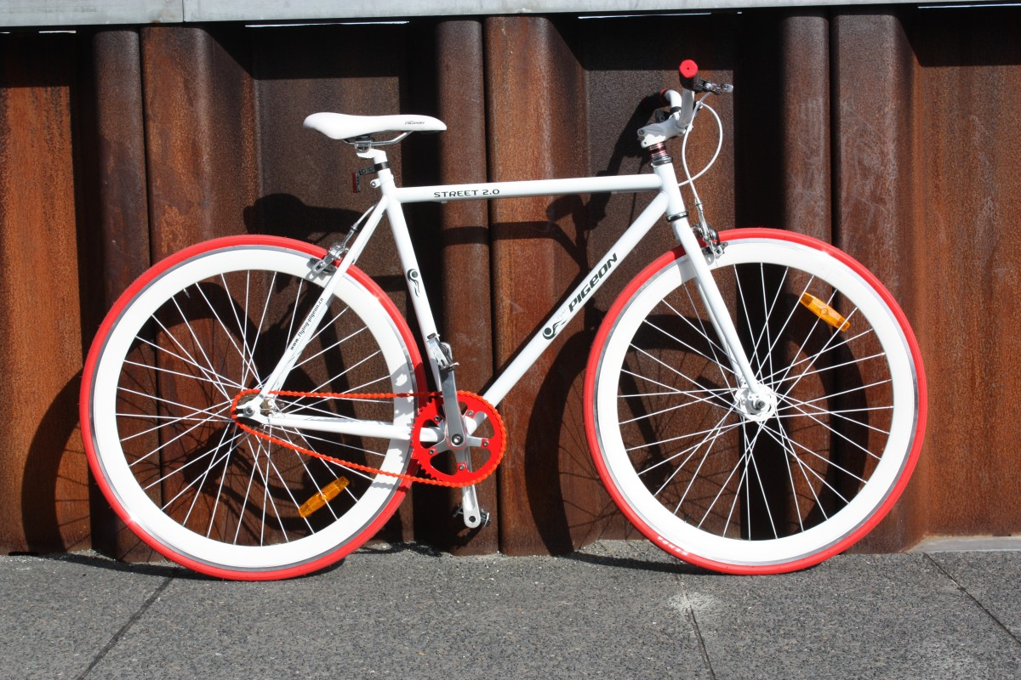
How can you help reduce the ozone layer?
Walk or cycle to school – Cycle to school week 23rd September
Don’t let your parents/grandparents leave their car engine on if waiting
Use water based products
Don’t use aerosols

Slide 9
Attendance
Dragons go to Y3, YR and Y4
Reception 99%
Year One 97.5%
Year Two 98.7%
Year Three 100%
Year Four 99.4%
Year Five 98.1%
Year Six 98.9%
Whole School 98.3%

Slide 10
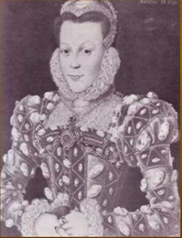
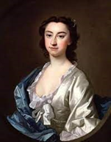
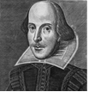
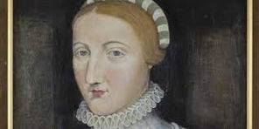
House Points
Arden
1230
WINNERS
Shakespeare
1249
Hall
1204
Hathaway
1158

Slide 11
Now for some Laughter Yoga

